Slide 1

UK Train Rides
By: Mohammed Amr & Ahmed Essam

Slide 2
The UK Train Rides Analysis project aims to improve the efficiency and reliability of the UK Train Rides by analyzing historical data. This analysis will identify patterns, and anomalies to provide actionable insights for optimizing operations, reducing delays and cancellations, and enhancing passenger experience. We can achieve that through:
Advanced Predictive Analytics for Weather Management.
Upgraded Signaling Systems.
Enhanced Workforce Management.
Proactive Maintenance for Technical Reliability.

Slide 3
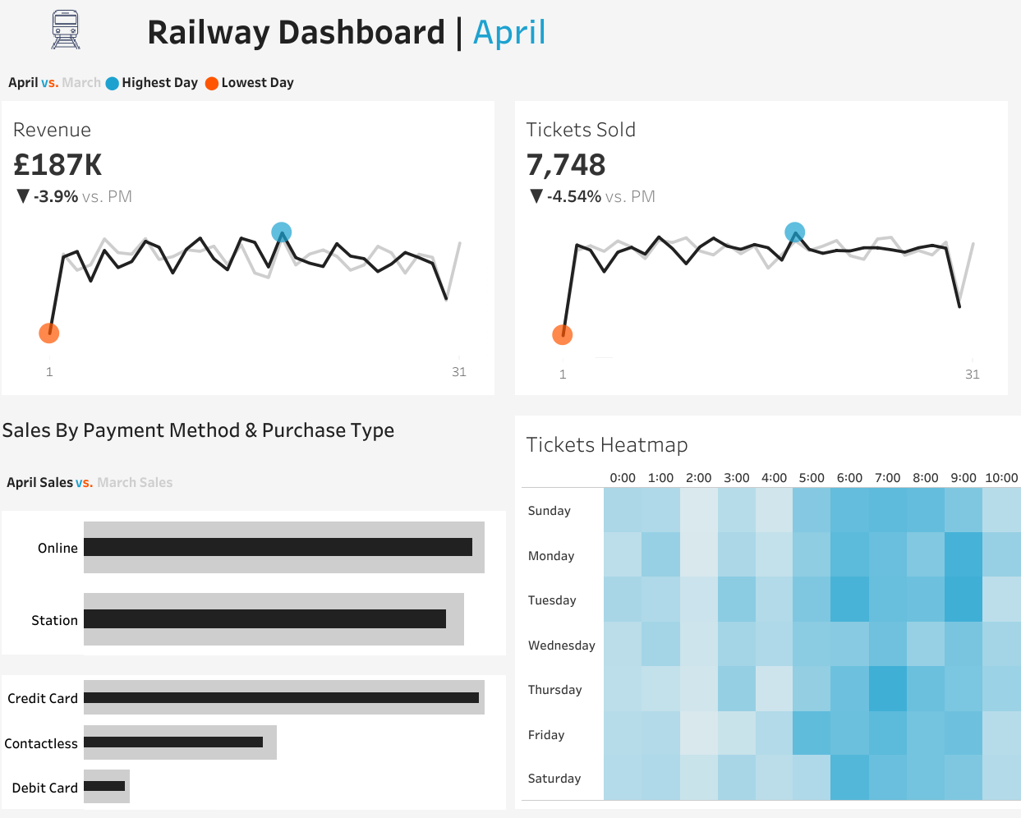
Railway Dashboard - Shows the revenue and the number of tickets sold for each month and compares the differences percentage with the previous month.
- Pinpointing peak and lowest revenue and tickets sold days.
- A heatmap visualizes tickets sold by hour and day of the week (Darker shades of blue indicate higher sales Volumes).

Slide 4
Stakeholders:
Railway Companies & Infrastructure Managers: Utilize data-driven insights for better planning, cost management, and service improvements.
Train Operators & Staff: Gain optimized scheduling, improved working conditions, and predictive maintenance tools for better service delivery.
Passengers: Benefit from reduced delays, better communication on disruptions, and enhanced onboard experiences.
Government & Regulators: Ensure compliance with regulations and guide future investments in railway infrastructure.
Technology & Maintenance Providers: Provide cutting-edge solutions to improve efficiency and reduce technical failures.

Slide 5
Data Cleaning
- Data Source: CSV file containing 18 columns and 31653 records.
- Cleaning Process and Accessing: Using Python (Colab Notebook).
- Designing Dashboard: Tableau Public.
Answering Analysis Questions
Designing Interactive Dashboard

Slide 6
Deliverables:
Project Documentation.
Notebook: Shows the cleaning and accessing process and Answering the analysis Questions.
Dashboard.
Business Insights Reports.
Presentation.

Slide 7
Project Team:
1. Mohammed Amr Abass (Team Leader):
- Ensure that all team members are on track and meeting deadlines.
- Data Cleaning and Processing.
- Provides insights and recommendations based on the analysis.
- Desings Dashboards.
2. Ahmed Essam Abdallah:
- Data Cleaning and Processing.
- Provides insights and recommendations based on the analysis.
- Desings Dashboards.

Slide 8
Any Questions ?

Slide 9
Thank You

